Slide 1

EaseInvests
Predicting Stock Prices using Morningstar’s Analyst Reports
Team # 7
Prince Kumar, Simon Jones, Amratansh Sharma, Lorena Bustamante
MGTM 59000-011: Web Data Analytics
Final Project | Dec. 6, 2018

Slide 2




The stock market is a dynamic space; ~ $183B of stock traded daily across the two major US exchange markets
Publicly
Traded Companies
NEW YORK STOCK EXCHANGE (NYSE)
2649 Companies
Total Market Cap: $28.52 trillion
Daily Volume: 1.9 billion transactions, $90 billion
Institutional
Investors
Stockbrokers
NASDAQ STOCK MARKET (NASDAQ)
3440 Companies
Total Market Cap: $10.82 trillion
Daily Volume: 1.6 billion transactions, $93 billion
licensed professionals who buy and sell securities on behalf of investors
Individual
Investors
Government (regulatory environment)

Slide 3
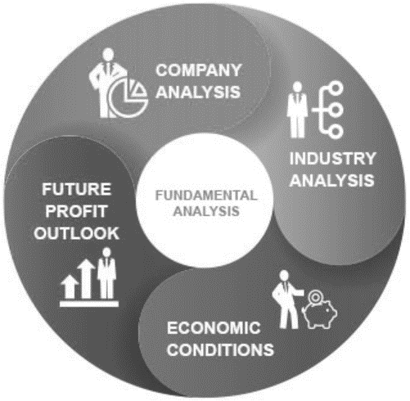
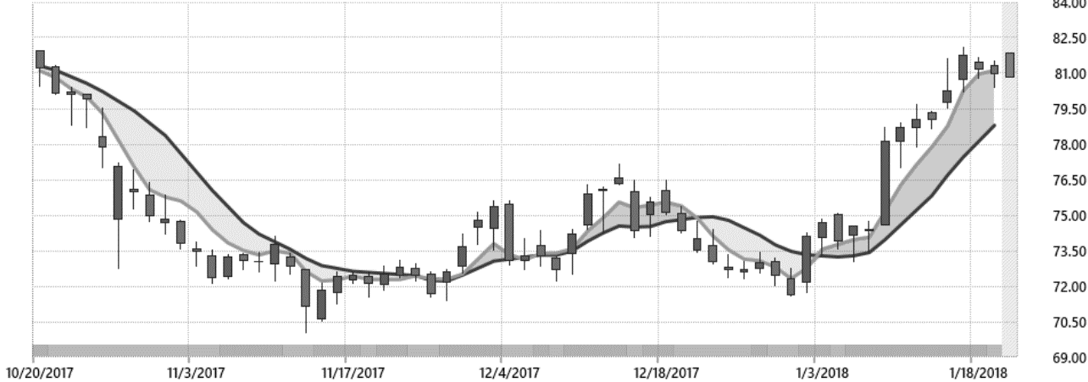
Investors aim to achieve gains by quickly analyzing data; two techniques are used extensively by professionals
TECHNICAL TRADING
FUNDAMENTAL TRADING
This method uses stock time series data to detect signs of convergence or divergence to identify buy and sell signals.
It is used primarily in short term trading.
This method examines corporate events (e.g., earning reports, stock splits, reorganizations, acquisitions) and competitive landscapes to identify buy and sell opportunities.
It is used primarily in long term trading.
Both techniques require expert training and, thus, not accessible to the average investor

Slide 4
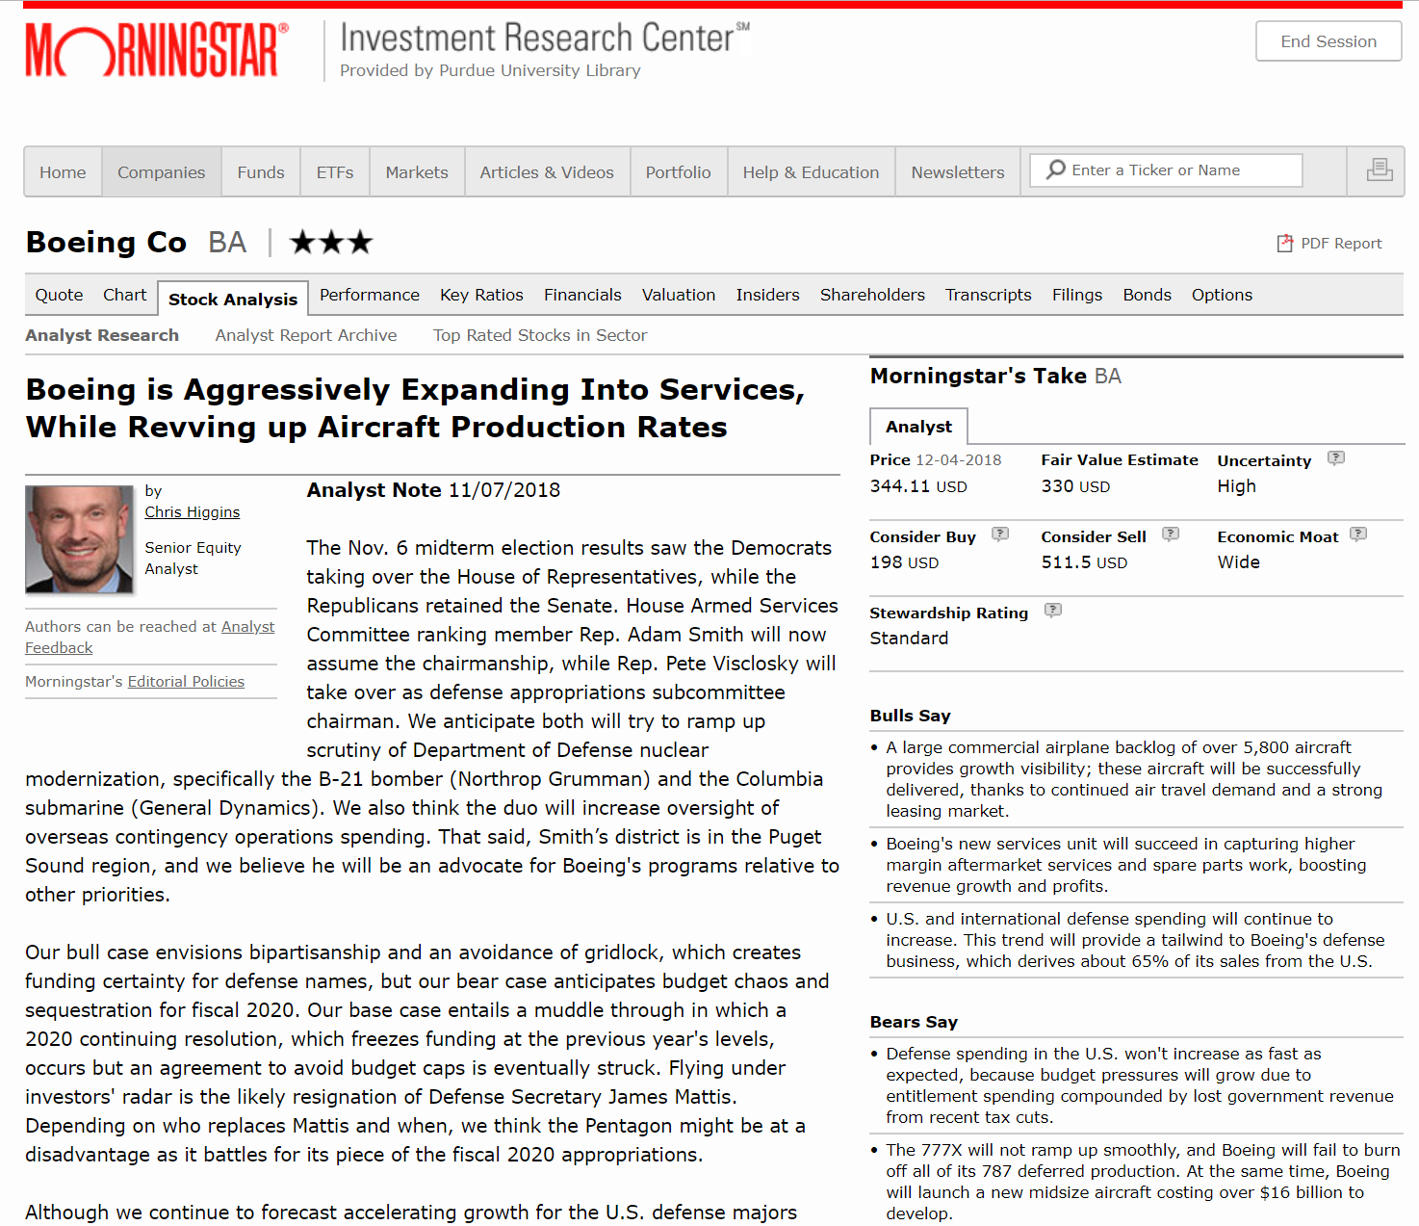
Investors circumvent the need to analyze data themselves by purchasing analyst reports
STRONG PREDICTIVE POWER
“Morningstar says that since it started rating stocks in June 2002 through July 31, wide-moat companies with “buy” ratings returned 17.8% a year, compared with 5.6% for Standard & Poor’s 500-stock index” (Frick & Leary, 2012)
“We find that stock prices increase (decrease) when analysts change their risk ratings toward lower (higher) risk controlling for changes in stock recommendations, price targets, earnings forecasts and contemporaneous news about corporate events” (Lui, Markov & Tamayo, 2010)
“This paper provides evidence on the market reactions to earnings forecast revisions, stock recommendations and revisions in stock recommendations contained in 576 sell-side analyst reports” (Francis & Soffer, 1997)

Slide 5

Although reports are available, some investors might find the text too technical and emotionless
LIMITATIONS OF REPORTS
Written with a technical language → difficult for non-expert investors to understand
Analysis relies on traditional stock prediction techniques (fundamental/ technical) → leaves investor emotions aside
“Our bull case envisions bipartisanship and an avoidance of gridlock, which creates funding certainty for defense names, but our bear case anticipates budget chaos and sequestration for fiscal 2020. Our base case entails a muddle through in which a 2020 continuing resolution, which freezes funding at the previous year's levels, occurs but an agreement to avoid budget caps is eventually struck”

Slide 6


Acknowledging the key role emotions play in the stock market, newer predictions incorporate emotional elements
BOLLEN, J., MAO,H., ZENG, X., (2010)
Used the emotions expressed in Twitter daily feeds to predict daily up and down changes in the closing stock prices → 87.6% accurate predictions
JOSHI, K., BHARATHI, H., RAO, J., (2016)
Used sentiment analysis of financial news articles about a company to predict future stock trends → 80% accurate predictions

Slide 7


We provide an online subscription service to investors looking for short-term gains with actionable stock insights
Calendar View:
Company View:
TODAY:
Apple Inc.
We offer a novel approach that incorporates both traditional and newer stock prediction techniques. Using NLP techniques we extract the analyst’s “sentiment” when generating a report and use it to predict movements in the market before the actual market reaction.
Expected to rise:
Apple Inc.
Microsoft Corp.
Today:
Stock expected to rise
Expected to drop:
Facebook Inc.
Target Corp.
In a week:
Stock expected to rise
Note. The views only represent a simple functional prototype (MVP) for our subscription service.

Slide 8



We combined several established sources of financial information as inputs to our predictive model
ANALYST REPORTS
QUARTERLY FINANCIALS
STOCK PRICES
Collected all analyst reports during Q4 2016 - Q3 2018 for the 15 largest companies¹ in the US in tech & retail
Extracted the report’s headline, first paragraph and conclusion
Collected, for each company, data on quarterly revenue, quarterly market capitalization, quarterly net income, quarterly EBITDA and date of announcement of quarterly earnings²
Gathered the daily close stock prices for the two year period for each company^{3,4}
Notes. 1) Size measured by total market capitalization; 2) From this, we created a new variable: time delta (date of report’s release – date of announcement of earnings); 3) In the case of holidays, we used the previous business date’s closing price; 4) From this we created our predictive variable: percent change in stock price from date of report (T0) to the next day, a week later and a month later.

Slide 9
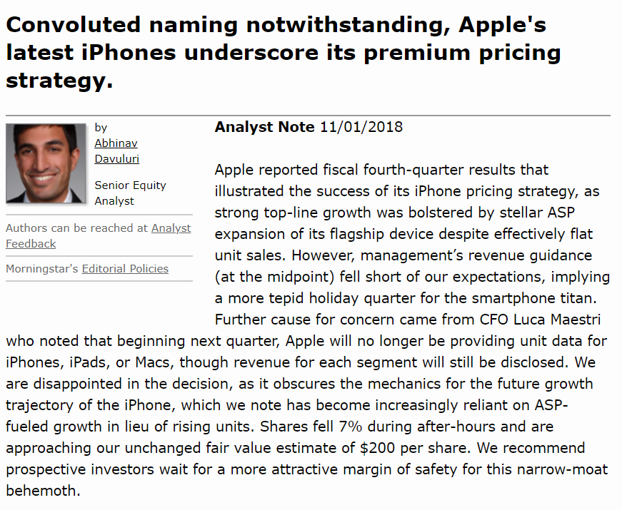
Using natural language processing techniques, we captured the sentiment from each analyst report
1
2
General Sentiment Lexicon
Financial Sentiment Lexicon
VADER
LOUGHRAN & MCDONALD
Sentiment scores¹:
Sentiment analysis lexicon specifically attuned to emotions expressed in social media.
Python library: NLTK
Lexicon based on EDGAR 10-K filings from 1994-2008 to capture the meaning of words used in financial documents.
Python library: pysentiment
 | General | Financial
Headline | -0.1531 | -0.999999
Introduction | 0.9382 | 1
Conclusion | -0.4173 | -1
Overall | 0.9081 | 0
Notes. 1) Higher scores denotes positive sentiment.

Slide 10



To predict stock prices, we calculated the percent price change in the stock’s closing price
(Stock Close Price at [TX] – Close Stock Price Day of Analyst Report [T0])
Close Stock Price Day of Analyst Report [T0]
=
X 100
%
Change in
Stock Price
October 25, 2016 (T0):
Close Price: $118.25
Example of Measure:
T1
T5
T30
Predict next day stock price
Predict next week stock price
Predict next month stock price
Close Price: $115.59
Close Price: $111.49
Close Price: $111.23
-2.249474841%
-5.716703594%
-5.936572516%
Notes. 1) To test our hypothesis we ran a combination of Linear and logistic regressions.

Slide 11
We used the sentiment in each report to predict the direction of stock price and the magnitude of the change
We expected positive analyst reviews to lead to an increase in the stock price
T1
T5
T30
Predict next day stock price
Predict next week stock price
Predict next month stock price
We expected positive analyst reviews to have a large effect on the stock’s price the day after the analyst report is published, because emotion plays a bigger role in short-term investing decisions (Wang, 2016).
Similar to T1, we expect positive analyst reviews to have a medium effect on the stock’s price a week after the analyst report is published. This is because a week remains within a short-term span (Wang, 2016).
As we move into the long-term effect, we expect analyst reviews to have a small effect on the stock’s price a month after the analyst report is published. This is because emotions play a smaller role in long-term investing decisions (Wang, 2016).
Notes. 1) To test our hypothesis we ran a combination of Linear and logistic regressions.

Slide 12

Using sentiment analysis of analyst reports we are able to predict short-term changes to the stock price
VALIDATES PRIOR EXPECTATIONS?
T1
With 98% confidence, on average, a 10% increase in the sentiment score of the headline and 1st paragraph of the analyst report, as measured by the general sentiment lexicon, results in a 0.5% increase in the stock price the next day after the report is published, controlling for other factors¹.
Predict next day stock price
T5
With 97% confidence, on average, a 10% increase in the overall sentiment score of analyst report, as measured by the general sentiment lexicon, results in an 0.2% increase in the stock price the week following the publication of the report, controlling for other factors¹ .
Predict next week stock price
T30
Relying on sentiment analysis, our model is unable to predict the effect on stock prices a month after the publication of an analyst report.
Predict next month stock price
Notes. Models control for the effects of market value, industry, and time delta (date of report’s release – date of announcement of earnings).

Slide 13
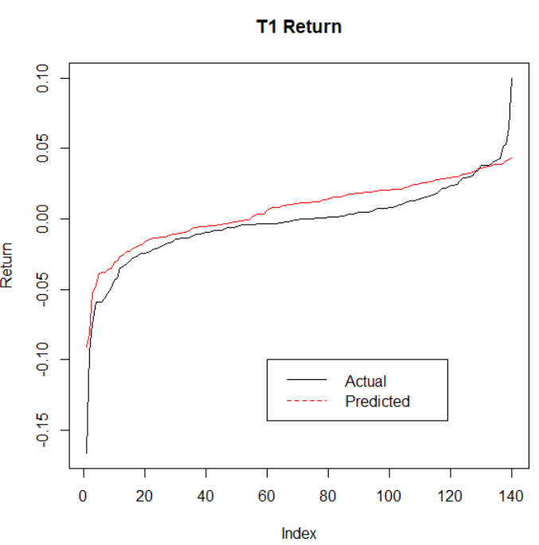
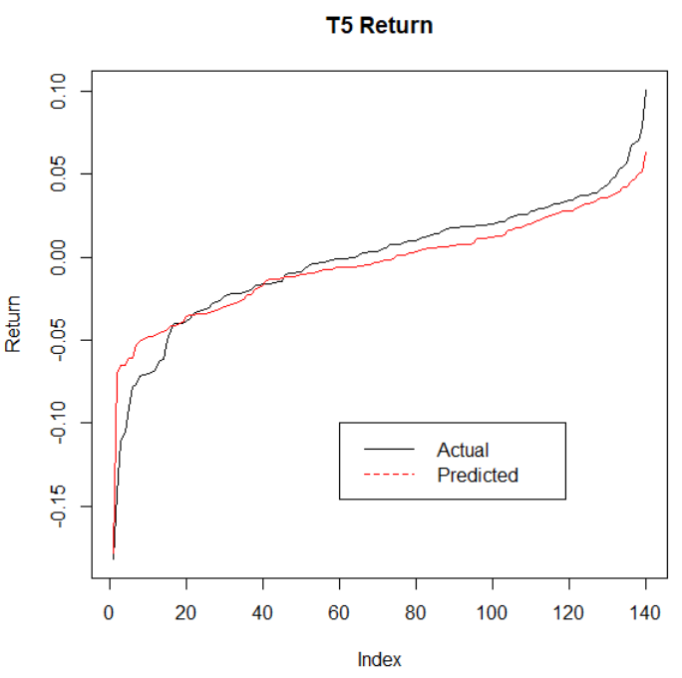
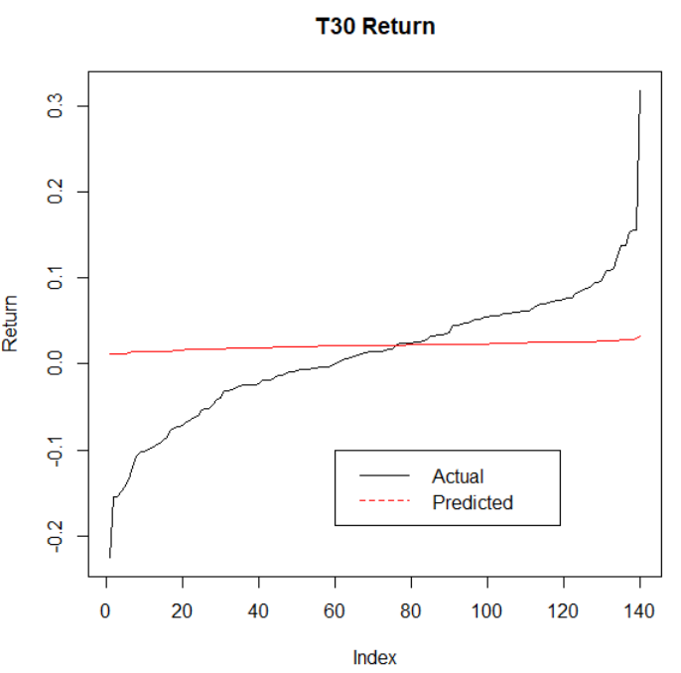
The predicted percent price change in the stock’s closing price for both T1 and T5 are quite accurate
T1
T5
T30
Predict next day stock price
Predict next week stock price
Predict next month stock price
On average, T1 model slightly overpredicts while T5 slightly unpredicts.
No prediction ability for T30.
Notes. 1) T1, T5 and T30 display linear regression model results (candidate model for both T1 and T5)

Slide 14

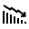

EaseInvests leverages these advanced analytics to provide value to active stock traders
SUBSCRIPTION SAVINGS
Eliminates the need for other subscription services
(e.g., Morningstar - $24 per month or $199 per year)
Introductory Pricing Rate: $10 per month
VALUE
PROCESSING EASE
To Individual Investors
Eliminates the time and effort required by individual investors to understand analyst reports
ACTIONABLE INSIGHTS
Identifies specific short term stock actions to take (daily and weekly announcements based on analyst report publications)

Slide 15
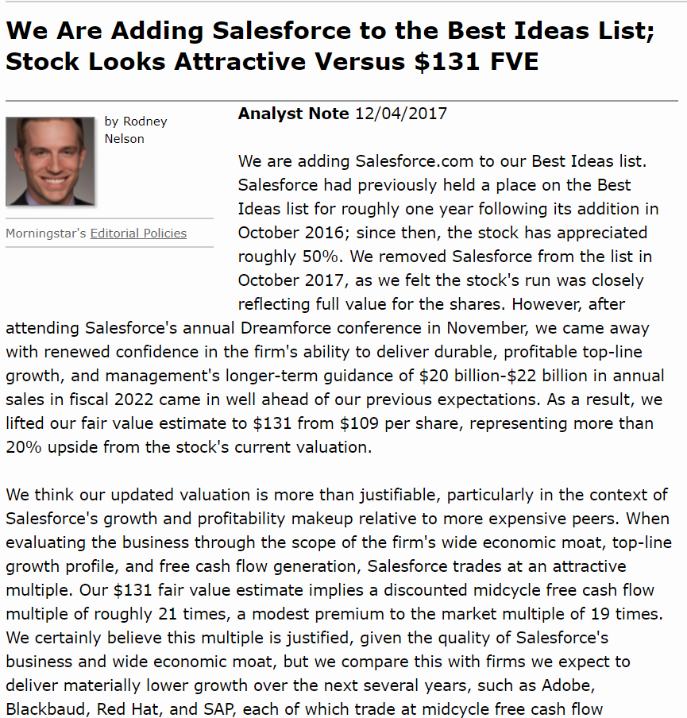

Using EaseInvests, an active trader with a $100 stake in Salesforce would have earned $4.69 in a week
December 4, 2017
Close Price: $99.85
EaseInvests Suggestions:
T1
T5
Tomorrow: Higher
December 5 2017
Next week: Higher
December 11, 2017
Close Price: $100.69
Close Price: $104.54
$0.84
$4.69
Value to Investor:

Slide 16
We will continue to enhance our service in order to provide more accurate stock predictions to our users
CURRENT PLATFORM
FUTURE UPDATES
Focuses on retail and tech and limited number of companies
Expand into more companies and industries
Processes Morningstar’s analyst reports
Expand beyond analyst reports to other emotional data: news, twitter, etc.
Focuses on US-based companies
Predict for companies traded in international stock exchanges

Slide 17
APPENDIX

Slide 18
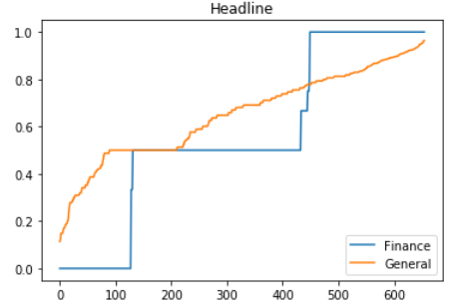
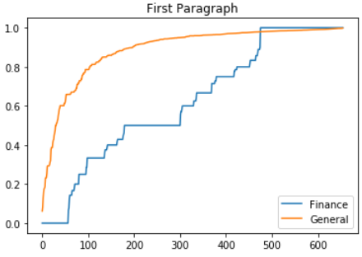
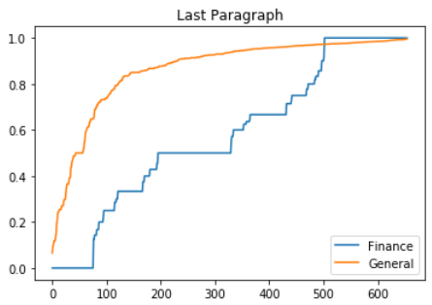
A. General Sentiment Lexicon vs. Financial Lexicon
Across all texts, the general sentiment score yields a higher sentiment score (more positive) for the analyst reports, compared to the financial lexicon
Notes:
Simon

Slide 19
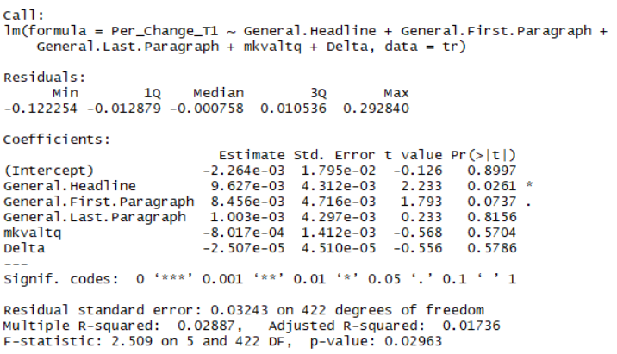
B. TI Linear Regression Model Results (Candidate Model)
Notes:
Simon

Slide 20
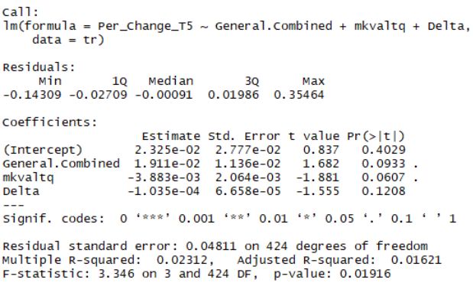
C. T5 Linear Regression Model Results (Candidate Model)
Notes:
Simon

Slide 21
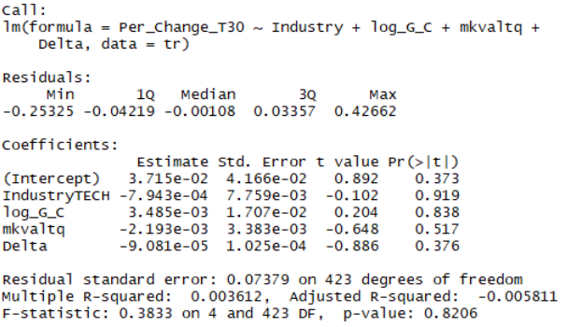
D. T30 Linear Regression Model Results
Notes:
Simon

Slide 22
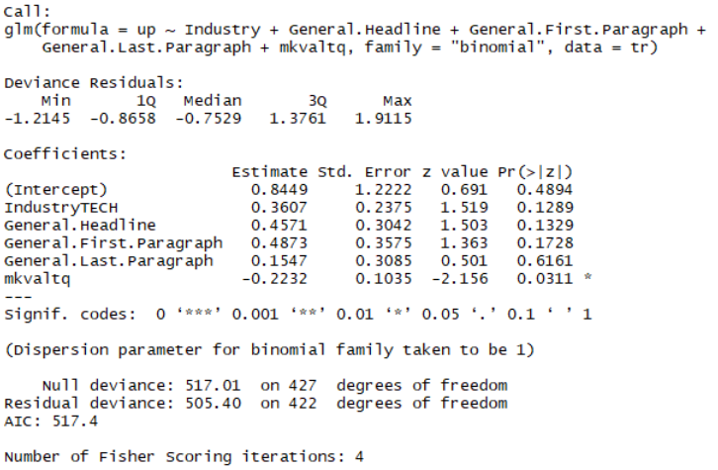
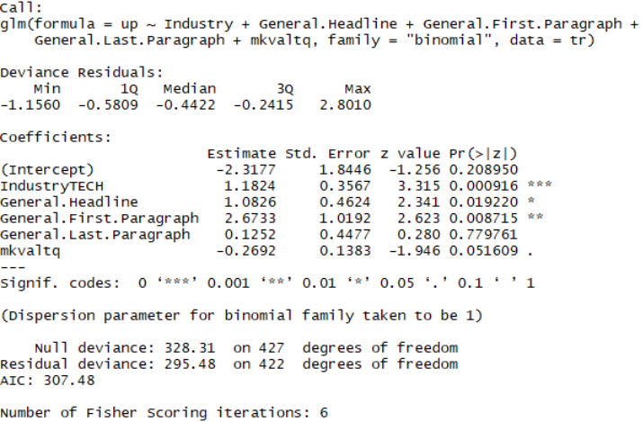
E. Logistic Regression Model for T1 and T5
T1 Logistic Model
T5 Logistic Model
Notes. 1) Categories: Rise +/- 2% vs. No-Rise +/- 2% (includes both no changes to stock or drop to the stock price)
Notes:
Simon

Slide 23
F. References
Allen H. Huang Amy Y. Zang Rong Zheng, Evidence on the Information Content of Text in Analyst Reports, THE ACCOUNTING REVIEW, Vol. 89, No. 6,2014,pp. 2151–2180
Bollen, J., & Mao, H., Twitter Mood As A Stock Market Predictor. IEEE Computer, 44(10):91–94.
Desjardins J. (2017), All of the World’s Stock Exchanges by Size, Visual Capitalist, February 2017. Retrieved from https://www.visualcapitalist.com/all-of-the-worlds-stock-exchanges-by-size/
Francis J. & Soffer L (1997). The Relative Informativeness of Analysts' Stock Recommendations and Earnings Forecast Revisions,Journal of Accounting Research Vol. 35, No. 2 (Autumn, 1997), pp. 193-211 (19 pages)
Frick b., Leary E., (2012). Where to Get the Best Stock Research, Kiplinger. August 2012. Retrieved from https://www.kiplinger.com/article/investing/T052-C008-S001-where-to-get-the-best-stock-research.html
Gregory W. Brown and Michael T. Cliff, Investor Sentiment and Asset Valuation, The Journal of Business, Vol. 78, No. 2 ,March 2005, pp. 405-440
Joshi, K., Bharathi, H., Rao, J.,(2016). Stock Trend Prediction Using News Sentiment Analysis. CoRR, abs/1607.01958.
Lui D., Markov S., Tamayo A. (2012). Equity Analyst and the Market’s Assessment of Risk, Journal of Accounting Research, Forthcoming. Retrieved from https://warwick.ac.uk/fac/soc/wbs/subjects/accountinggroup/eventsandseminars/equity_analyst_-_tamayo.pdf
Mittal A., ,Goel A., ,Stock Prediction Using Twitter Sentiment Analysis , 2011. Retrieved from http://cs229.stanford.edu/proj2011/GoelMittal-StockMarketPredictionUsingTwitterSentimentAnalysis.pdf
Van Bergen J. Intro to types of trading: Technical Traders, Investopedia, February 2018. Retrieved from https://www.investopedia.com/articles/trading/02/091802.asp#ixzz5YgAaC0Ti
Wang H., 2016. Long-term and Short-term Stock Prices Prediction with Sentiment. Retrieved from https://medium.com/@haohanwang/long-term-and-short-term-stock-prices-prediction-with-sentiment-978301fd10aa
WSJ, (2018). Market Data Center, US Stocks December 4,2018. Retrieved from http://www.wsj.com/mdc/public/page/2_3021-tradingdiary2.html

